Slide 1

REGEX Matcher App Deployment

Slide 2
About me
Background:
I am Surya Atrish pursuing B.Tech in Computer Science and Engineering with a strong interest in Python and Data Analytics.
Motivation for Data Science:
Since the start of my undergraduate life, I was deeply interested in Python, its various libraries and frameworks and all the various kinds of problems it can solve. So, I started learning about it, started doing projects. At the same time, I also completed an internship on Data Analytics in Python, SQL Tableau and Power BI. Through research and introspection, I discovered that Data Science resonates deeply with me, offering a perfect fit for my aspirations and skills.
Work Experience:
I am Currently interning at Innomatics Research Labs, transitioning from a computer science and engineering background to data science.
LinkedIn: https://www.linkedin.com/in/surya-atrish/
GitHub: https://github.com/suryaatrish

Slide 3
Objective:
The aim of this project is to develop a Regex Matcher web application that enables users to input a test string and a regular expression (regex) pattern. Upon submission, the application will identify and display all matches found in the test string based on the provided regex pattern. Additionally, the application will offer functionality for validating email addresses entered by users. By providing a user-friendly interface for regex matching and email validation, the web application seeks to streamline the process of pattern matching and enhance user productivity.
Key Features:
The Regex Matcher app will empower users to effortlessly test regex patterns against sample text strings, facilitating efficient data extraction and manipulation tasks. Furthermore, the integrated email validation feature will offer users a convenient method to verify the correctness of email addresses, ensuring data integrity and accuracy in various applications. With a focus on simplicity and functionality, the Regex Matcher app aims to serve as a valuable tool for developers, data analysts, and individuals requiring precise pattern matching capabilities.

Slide 4
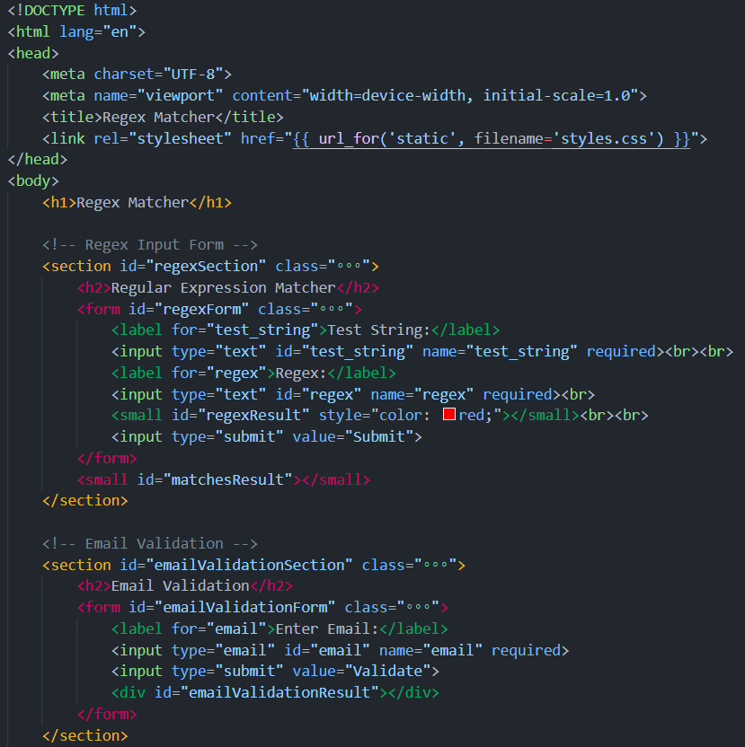
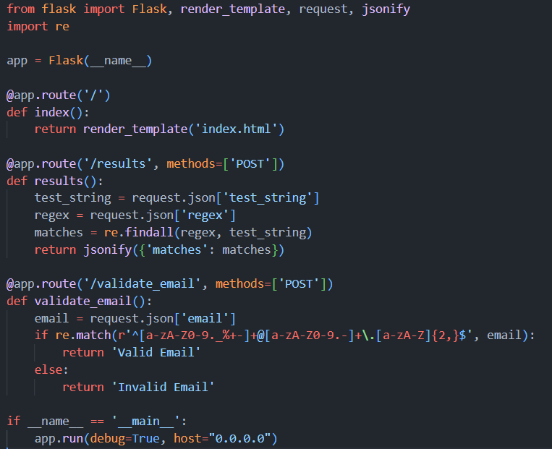
Codebase:
HTML:
Python:

Slide 5
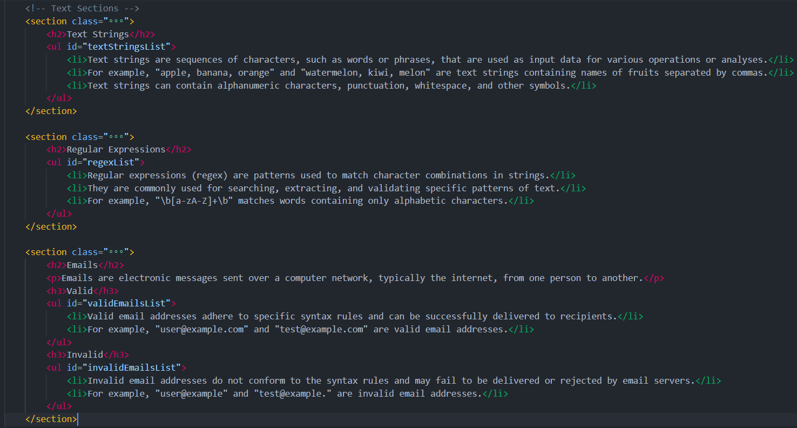
Codebase:

Slide 6
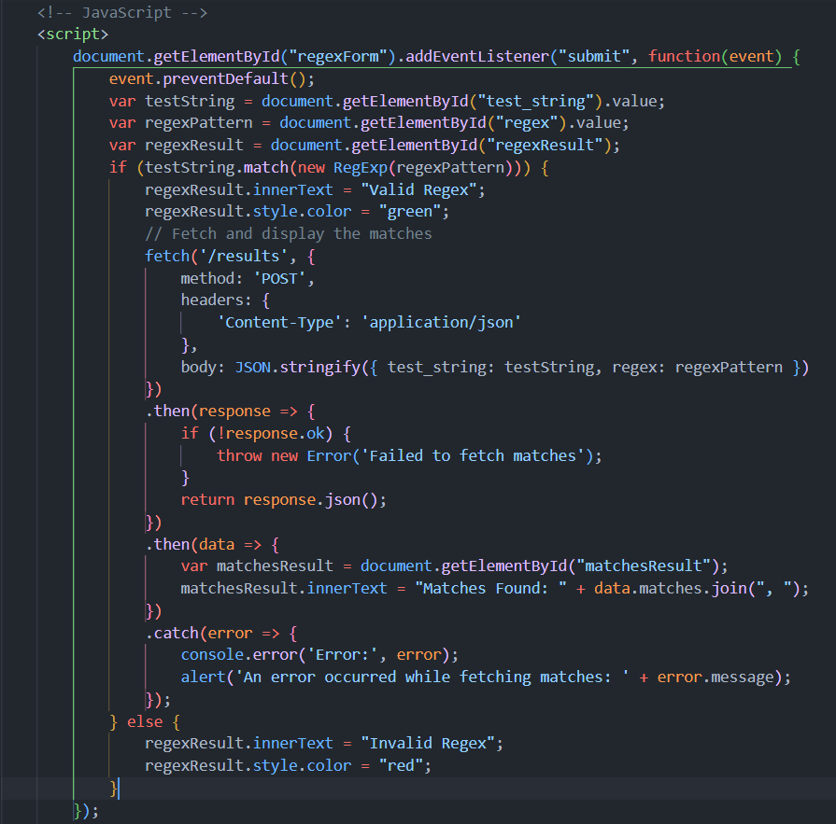
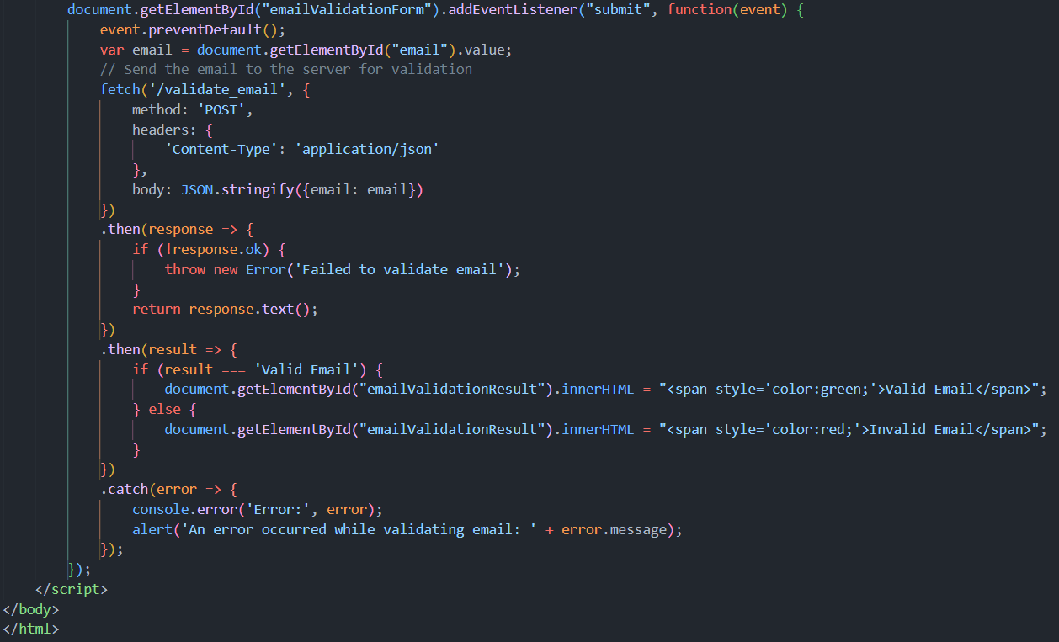
Codebase:

Slide 7
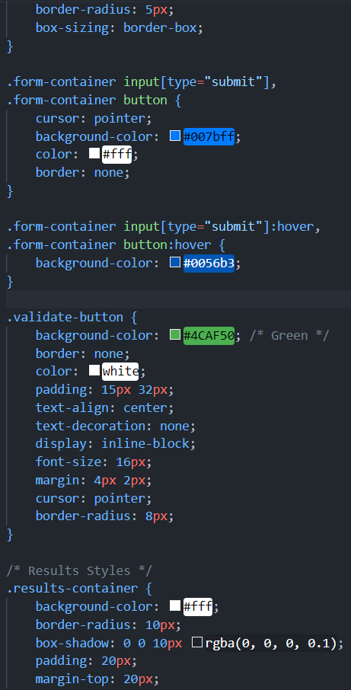
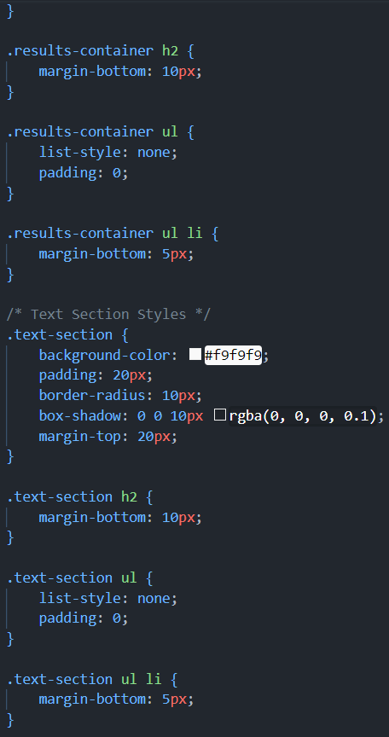
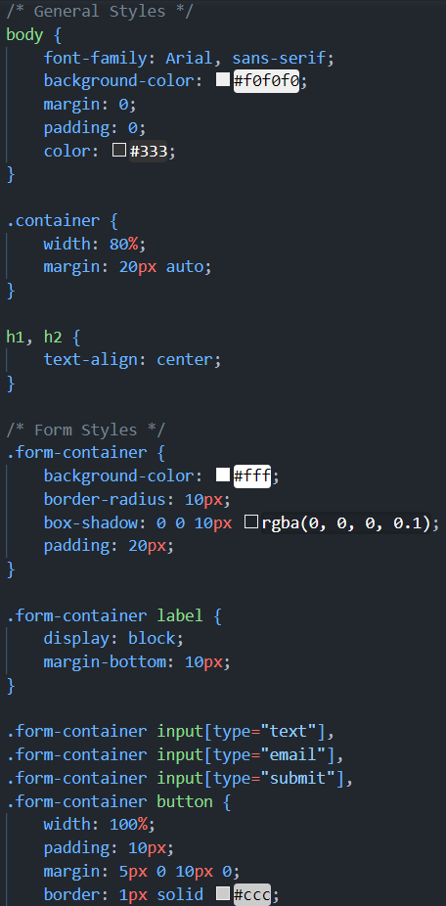
Codebase:
CSS:

Slide 8
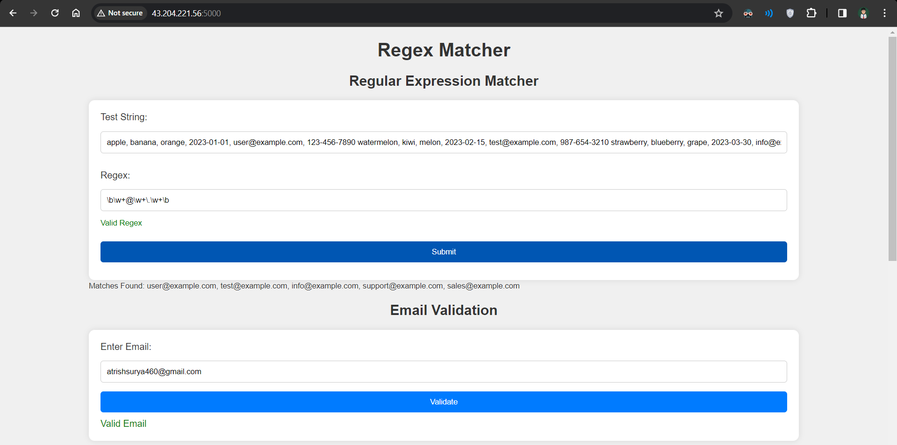
Final Output and Directory Structure:

Slide 9
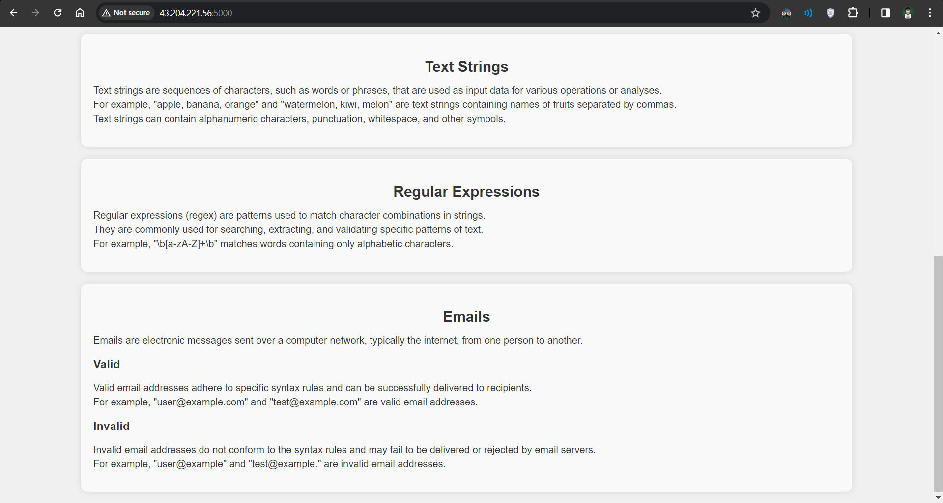
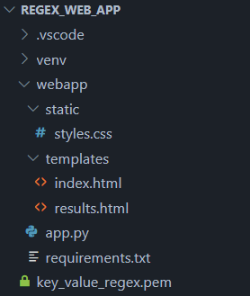
Final Output and Directory Structure:

Slide 10
Conclusion:
In conclusion, the Regex Matcher web application provides users with a convenient platform for pattern matching and email validation tasks. By allowing users to input a test string and a regular expression (regex) pattern, the application efficiently identifies and displays all matches found in the test string based on the provided regex pattern. Additionally, the integrated email validation feature offers users the capability to verify the correctness of email addresses, ensuring data integrity and reliability.
Through its user-friendly interface and robust functionality, the Regex Matcher app serves as a valuable tool for developers, data analysts, and individuals requiring precise pattern matching capabilities. By streamlining the process of regex matching and email validation, the application enhances user productivity and facilitates efficient data extraction and manipulation tasks. Overall, the Regex Matcher web application empowers users to effectively tackle pattern matching challenges and achieve accurate results in various applications and scenarios.

Slide 11

THANK YOU

